Slide 1
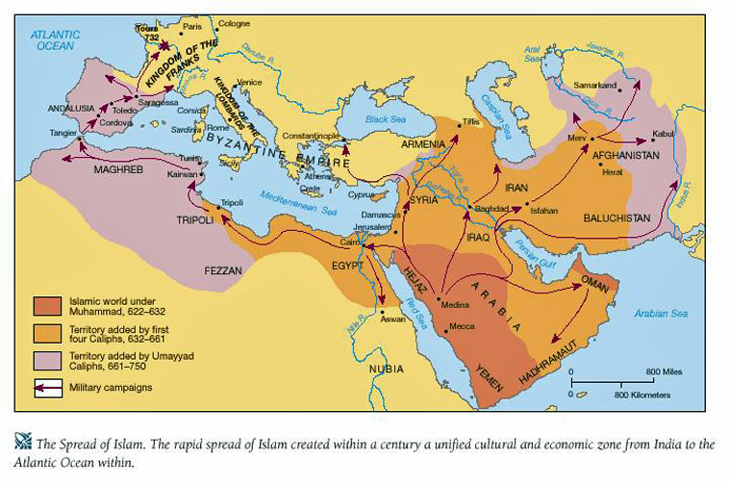
Arab and Turkish Invasions

Slide 2
Rise and Spread of Islam
In the 7th Century CE a new religion called Islam was founded in Arabia by Muhammad.
In a very short period of time , Islam carved out an empire extending from north Africa to the Iberian Peninsula , to Iran and India.
This Religion transformed the religious , political and social life.

Slide 3
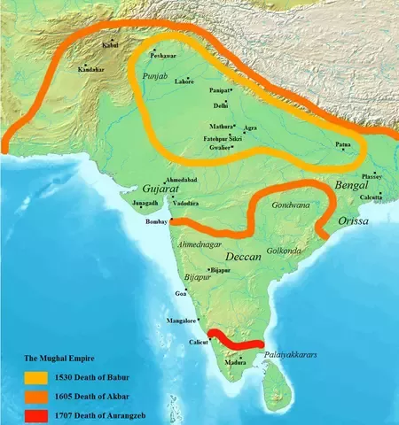

Slide 4
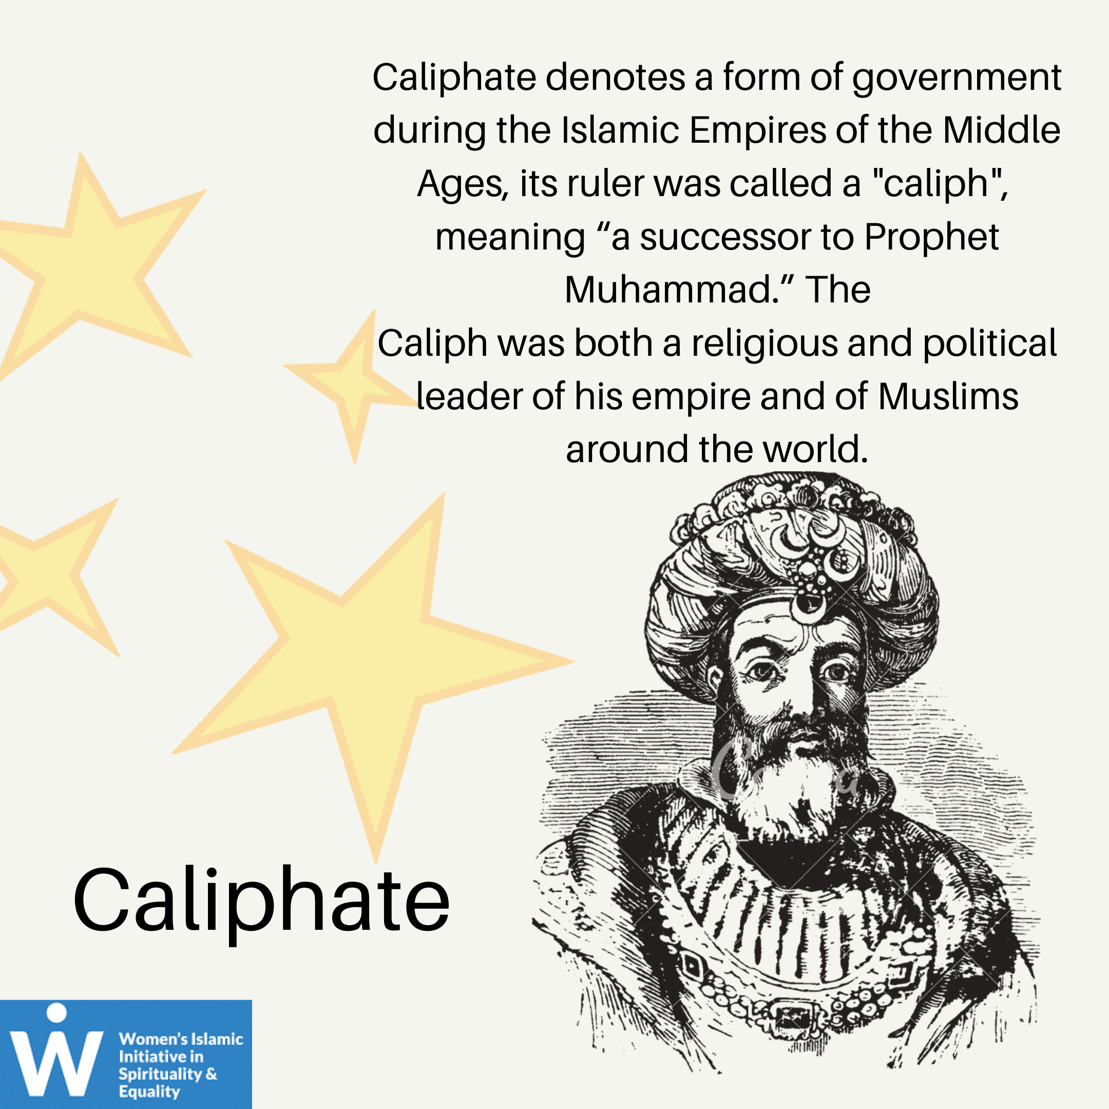
Islam lays an Emphasis upon the belief in one god (Allah) and its holy book the Quran.
In 613 Muhammad found himself receiving messages from Allah and learned that he was a Prophet in the same line as Moses and Jesus Christ.
After the death of the Prophet in 632 CE , the task of providing religious and political leadership to the Muslims passed on the Caliphs (Islamic leader)

Slide 5
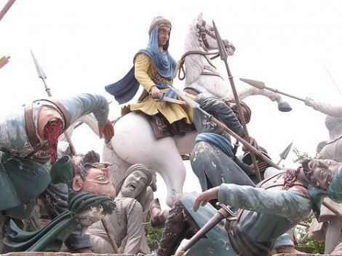
The word Caliph is derived from Arabic word Khalifa (Deputy).
As a part of the expansion policy of the Umayyad Caliphate ,the invasions started as early as the 8th Century in India.
In 712 AD, Arabs invaded India from the North West Region (Sindh)
Md Bin Qasim invaded India in 712 AD.
Md Bin Qasim was a general of Umayyad Caliphate.
The Arabs were attracted by the rich ports of Sind. They wanted to extend their political and religious control over it, but failed to check the pirates who plundered them

Slide 6
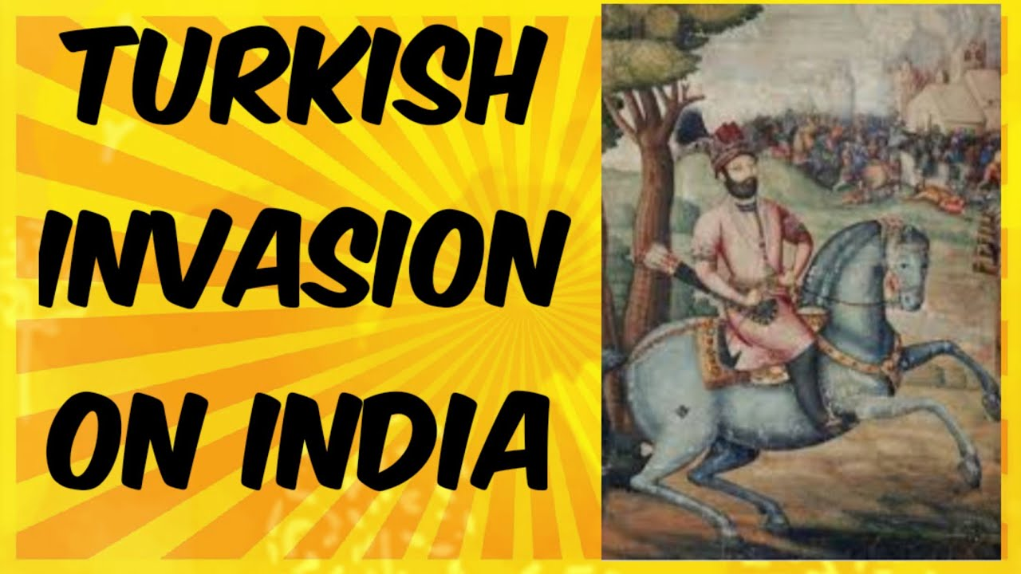
Turkish Invasion
The Turks got the upper hand over the Caliphs of Baghdad in the 8th and 9th centuries
They completed the work begun by the Arabs and extended their dominion beyond Sind and Multan into India.
Alptagin established an Independent Turkish dynasty in 962 AD, with its capital at Ghazni (Present day South Kabul).
He was (Alptagin) succeeded by his slave and son- in – law’s Sabuktagin.
Sabuktagin established his own rule in Ghazni in 977.

Slide 7
First Turkish Invader in India - Sabuktagin
Sabuktagin defeated King Jaypala in 988 AD.

Slide 8
Sultan Mahmud
Sabuktagin’s son Mahmud ascended the throne at Ghazni.
Mahmud was the first ruler to get the title “ Sultan”
He attacked India 17th times between 1000-1027 AD.
He started his invasion in India during the period when the Rajput power had declined.
The main reasons behind Conquest of India by Mahmud Ghazni were to accumulate the vast amount of wealth that existed in India. With the help of that wealth , he wanted to transform Ghazni his capital city , into a region of formidable power in the entire central Asia

Slide 9
Along with He wanted to spread Islam and to destroy Hindu temples.
In 1000 AD , he first invaded modern Afganistan and Pakistan and defeated the Hindu Shahi ruler Jayapala in the battle of Waihind.
In 1008 AD, the second battle of Wahind between Mahmud and Anandapala (Son of Jayapala) was fought near Peshwar and defeated the alliance of Anandapala, Ujjain, Gwalior, Kalinjar, Kannauj, Delhi and Ajmer.

Slide 10
In his 16th expedition , he plundered the Somnath temple dedicated to Shiva in Kathiawar , Saurasthra.
Court Poet Firdausi ( He wrote Shahnama), Alberuni (He wrote Kitab – Ul – Hind) and Historian Utbi (He wrote Kitab – Ud- Yamini) Visited in India during his time

Slide 11
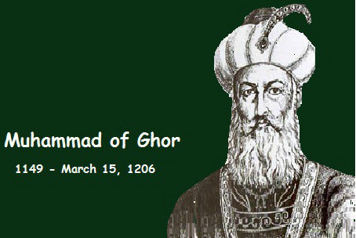
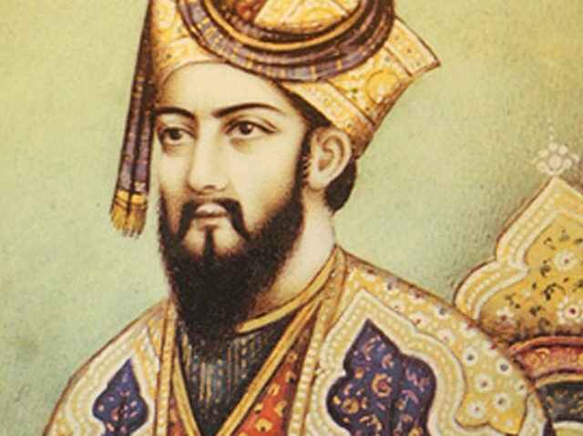
Muhammad of Ghori
Muhammad was the third important Muslim invader of Hindustan.
He became the ruler of Ghori. Ghori, being a very ambitious leader was not satisfied with only Ghazni and wanted to expand his empire to get hold of more power and control.
It is pertinent to note that unlike Mahumud of Ghazni, Ghori was very much interested in establishing a permanent empire in India and not merely looting its wealth.

Slide 12
First Battle of Tarain (1191 A.D.)
In 1189 A.D. Muhammad of Ghori captured the fortress of Bhatinda and advanced into the kingdom of Prithviraj Chauhan
Prithviraj marched against him with a large force and defeated Muhammad of Ghori in the Battle of Tarain in 1191 A.D
Prithviraj also recovered Bhatinda, which was earlier occupied by Mahmud of Ghazni

Slide 13
Second Battle of Tarain (1192 A.D.)
He gave a crushing defeat to the combined forces of the Rajput rulers under Prithviraj at Tarain.
Prithviraj was imprisoned and later put to death
The Second Battle of Tarain marked the beginning of the Turkish rule in the heart of Hindustan for the first time in Indian history
Muhammad of Ghori appointed Qutb-ud-din Aibak as his commander.

Slide 14
Rajput Uprisings and Battle of Chandwar (1194 A.D.)
Between 1193 and 1198 A.D. there were many Rajput uprisings
Qutb-ud-din Aibak put them down and brought many of their territories under his control
Delhi was made the capital of Muhammad of Ghori's territory in India.
Muhammad of Ghori marched against Jaichandra, the greatest Rajput ruler of Kanauj in Battle of Chandwar (1194 A.D.)
Jaichand was struck in the eye by an arrow and he was killed by Muhammad of Ghori

Slide 15
Conquest of Bengal and Bihar
Muhammad-bin-Baktiyar Khilji, one of the commanders of Muhammad of Ghori attacked Bengal.
Destroyed Vikramasila and Nalanda Universities in 1202-1203 A.D

Slide 16


